Slide 1
Design and Verification of 4-bit serial adder using Verilog
R.MEGHANA 1NT18EC118
Under the Guidance of
Dr.Sowmya Madhavan
Associate Professor
Dept. of Electronics and Communication
Engineering
Nitte Meenakshi Institute of Technology
Yelahanka, Bangalore-560064
INTERNSHIP PRESENTATION

Slide 2
Presentation Outline
Overview of the Company
Products made by Company
Program Description
Internship Work description
Adders and its applications
Work Carried Out
Conclusion

Slide 3

Overview of the Company
Head Quartered at Bangalore, India, Entuple Technologies was Founded on 1st January 2010 by professionals with a combined experience of over 80 years in the Electronics Industry.
Combined from the words "Enable" and "n-tuple", Entuple is suggestive of enabling multi-dimensional possibilities and growth for all their stakeholders.

Slide 4
Overview of the Company
The objective of the company is to provide precise quality solutions to their customers and win loyalty by leveraging their technical capability. Satisfaction of the customer is valued and is of paramount importance right from the beginning of the engagement with the customer.
The management team with its experience in different sectors such as Aerospace & Defence, Small & Medium Business, Research & Academia has joined together to build a world class team of Next Generation Solution Enablers in system design technologies. Partnering with technology leaders in such areas they also bring together a dynamic eco-system for their customers.
In the academic sector, Entuple is committed to bridge the growing gap between curriculum and advancements in the industry by providing effective tools, technologies and enablement to the campuses.

Slide 5
Products Made by Company
Automated Test Equipment (ATE) : It plays a crucial role as it enables more vigorous testing at faster rates and in a more controlled manner than was previously possible using manual procedures. ATE can involve a single measurement made continuously at very high rates or multiple measurements made by a host of different instruments.
Wavect - Control and Measurements : Wavect real–time control prototyping system is modular, scalable and supported by a powerful model based design environment. It is ideal for leading edge research and development in power conversion systems. They provide example designs and hardware setups for applications such as Motor drives, Renewable Energy systems, Power Quality, Electric Vehicles and Microgrid etc.
Antenna Feed : An antenna feed may be insignificant in size but plays a very important role in attaining the required performance of the intended RF beam. At Entuple, they specialise in making custom feeds for particular applications.

Slide 6
Program Description
Outcomes of internship program:
Complete understanding of ASIC flow and FPGA flow
Learning Verilog constructs
Combinational circuit design using Verilog
Sequential circuit design using Verilog
Understanding modeling of a state machine
Writing Test bench for a given design

Slide 7
Internship work Description
Trained in Design and Verification using Verilog(both theory and lab session)
Assigned project to design and verify a 4-bit serial adder as per the mentioned problem statement
Cadence genus and EDA playground were used for simulating the developed RTL code along with the testbench for the same assigned problem statement
Detailed report along with the simulated waveforms was prepared and submitted
Final project results was analysed

Slide 8
Adders and its applications
An adder is a digital logic circuit in electronics that is extensively used for the addition of numbers. Adders are basically classified into two types: Half Adder and Full Adder.
In many computers and other types of processors, adders are even used to calculate addresses and related activities and calculate table indices in the ALU and even utilized in other parts of the processors
Adder are basically used for performing arithmetical functions like addition, subtraction, multiplication and division in electronic calculators and digital instruments
They are also used in microcontrollers for arithmetic additions, PC (program counter) and timers
It is also used in networking and DSP (Digital signal processor) oriented system
Adders are used in digital calculators for arithmetic addition and devices that uses some kind of increment or arithmetic process

Slide 9
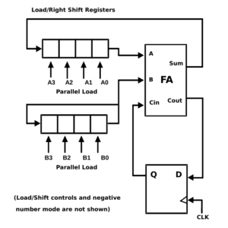
Work Carried Out ( 4-bit serial adder )
Using Verilog, Designing and Verifying a 4 bit Serial adder as shown in below block diagram?

Slide 10
Work Carried Out ( 4-bit serial adder )
Brief Explanation Of 4-Bit Serial Adder With Parallel Load
It consists of two 4-bit shift registers with parallel load, a full adder, and a D-type flip-flop for storing carry-out. In order to load data (4-bit) to these shift registers initially, shift capability of the registers should be disabled and loading mode should be enabled. Loading of numbers to these shift registers will occur in one clock cycle. After this, shifting mode should be enabled to perform the arithmetic operation. The addition of numbers stored in these shift registers requires 4 clock cycles. Starting with LSB (least significant bit), at each cycle one bit of first number and one bit of second number are being added. The sum is stored at the MSB (most significant bit) of first shift register as in circuit above. Carry-out output produced after each cycle is fed-back to the full adder as a carry-in of the next significant bit. For this purpose one D-type flip-flop is used as a temporary storage element. The LSB of the data in second shift register is fed as the input to the MSB of the same data. Hence rotation operation of this second shift register happens.

Slide 11
Work Carried Out ( 4-bit serial adder )
Here initially the two shift registers are loaded with data 1011 and 1000 respectively. Initially Cin is set as 0. When reset=1 data is fed parallely to these shift registers and output is 0. When reset=0, shift operation is performed be these registers. A variable count is declared because we just have to shift data 4 times in order to calculate sum of a 4-bit number. Therefore when count<4, enable=1 the circuit adds the LSB bits. When count>0 and enable=0 the same output value is retained.

Slide 12
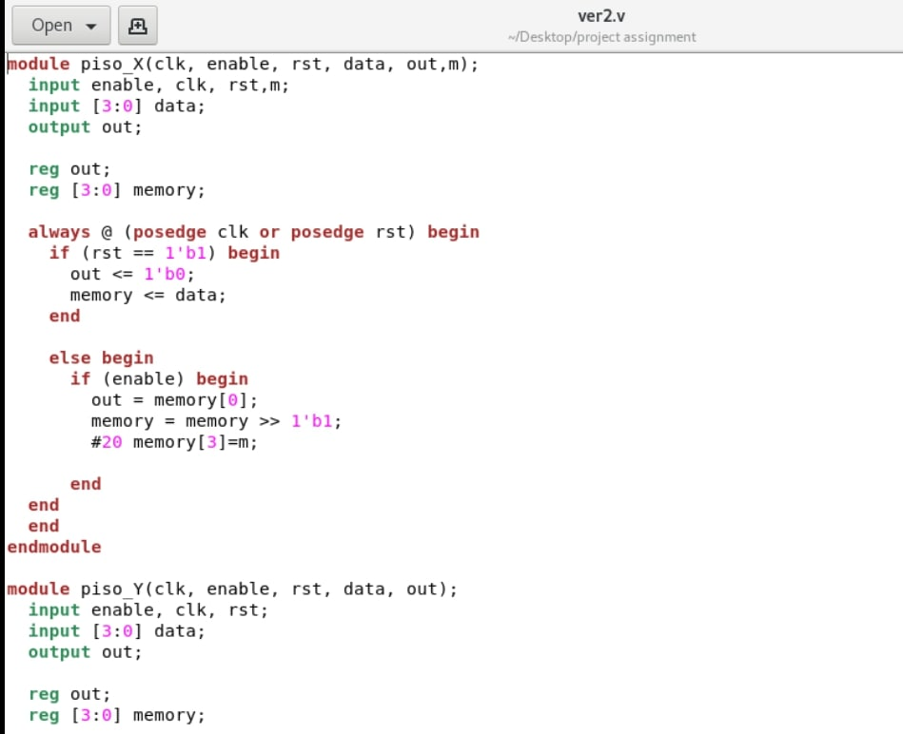
Work Carried Out ( 4-bit serial adder )
Code

Slide 13
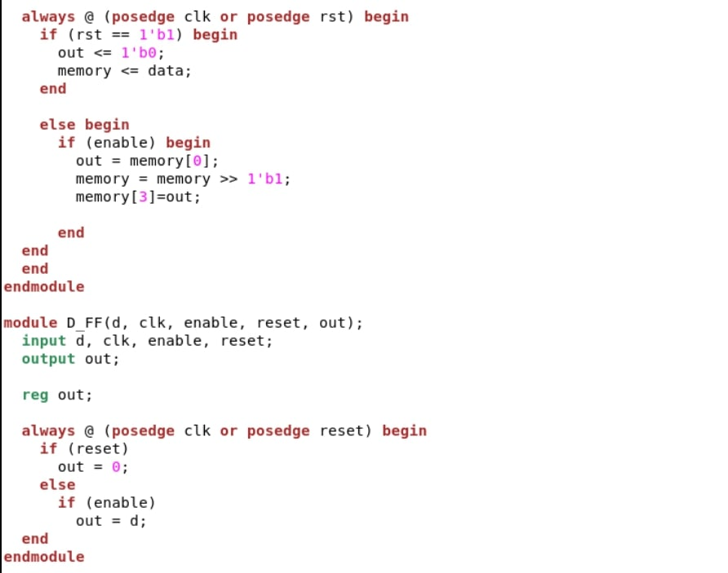
Work Carried Out ( 4-bit serial adder )

Slide 14
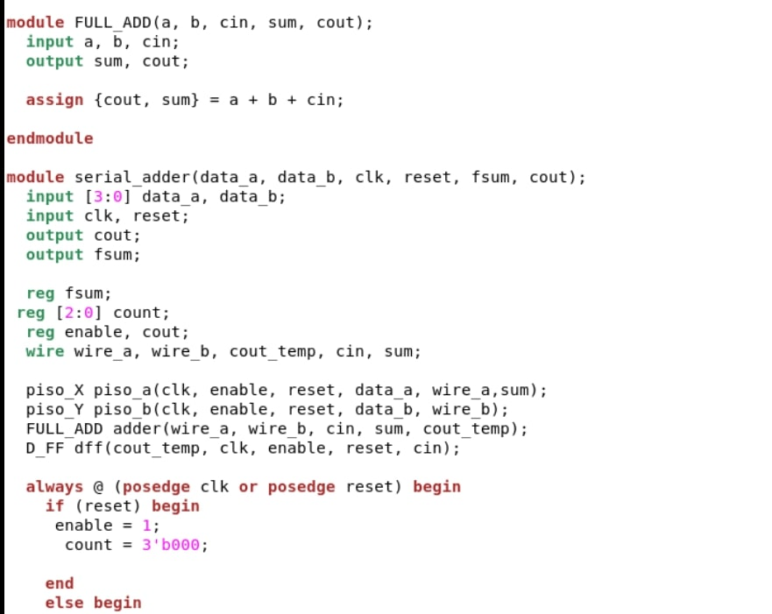
Work Carried Out ( 4-bit serial adder )

Slide 15

Work Carried Out ( 4-bit serial adder )

Slide 16
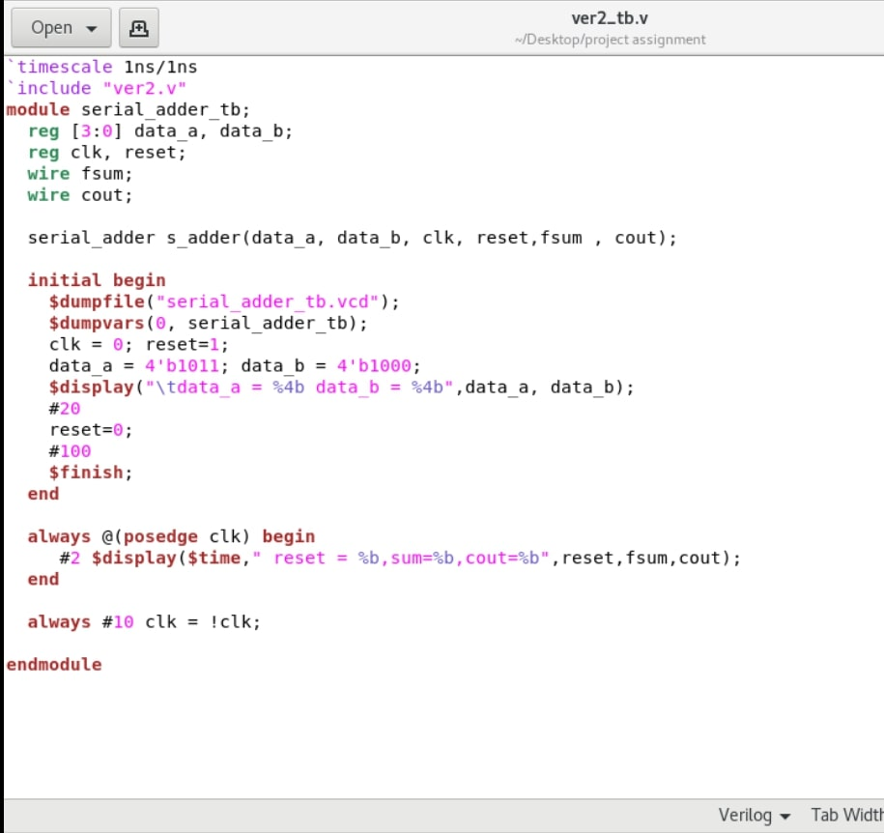
Work Carried Out ( 4-bit serial adder )
Testbench

Slide 17
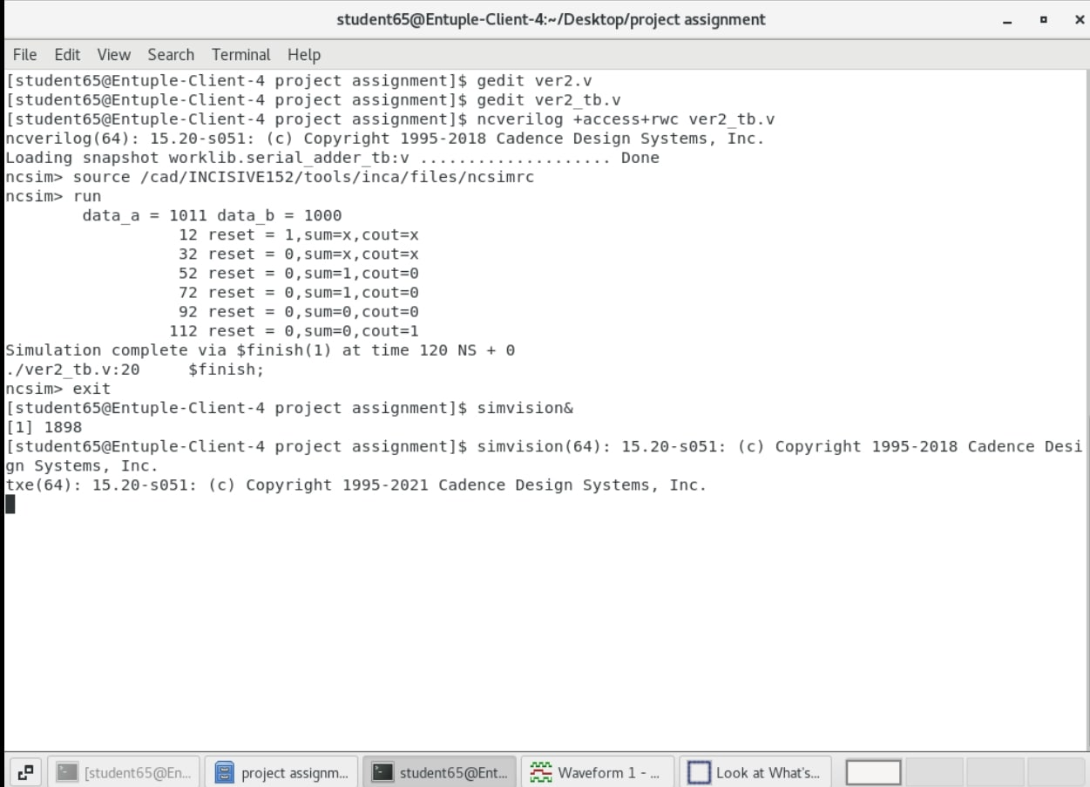
Work Carried Out ( 4-bit serial adder )
Simulation and Implemention

Slide 18
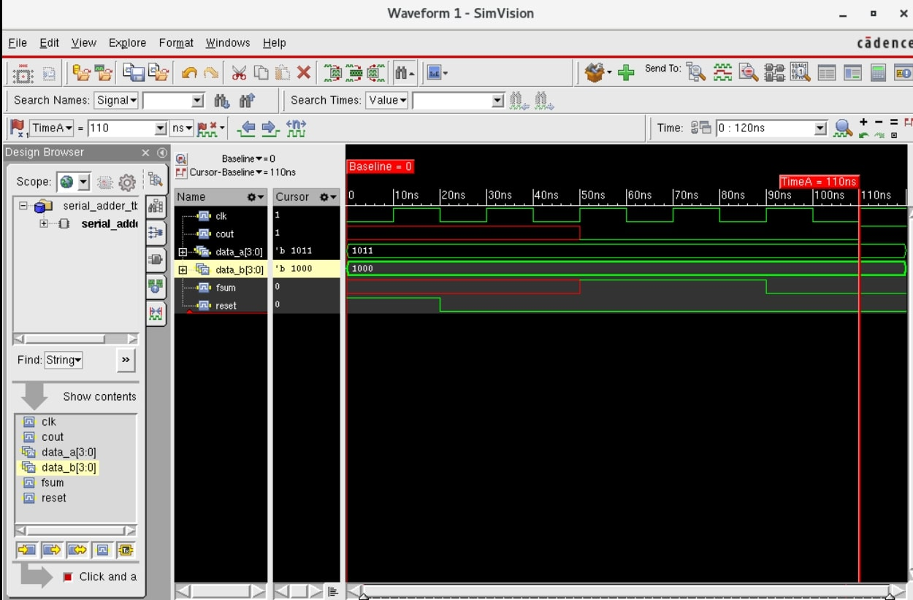
Work Carried Out ( 4-bit serial adder )

Slide 19
Conclusion
As seen in the above simulated waveform, there are two 4-bit shift registers namely register a and register b which are loaded with 4-bit data each i.e,1011 and 1000 respectively. This loading of data to registers take one clock cycle. During further clock cycle LSB bits are added considering Cin=0. Output of this addition is assigned to registers sum and Cout. This repeats for four clock cycles to ensure the addition of four bits. Final sum and Cout registers each of 4-bit will have 0011 and 1000 respectively. There is a input reset signal given to 4-bit shift registers. When reset=1, data is fed parallely to these shift registers and output is 0. When reset=0, shift operation is performed by these registers. we have to shift data 4 times in order to calculate sum of a 4-bit number. So, a variable count is declared for this. When count < 4, enable=1 the circuit adds the LSB bits. When count > 0 and enable=0 the same output value is retained.

